Slide 1






Midterm Sleep Patterns Among Nursing Students
Calalang, Ingaran, Peña

Slide 2

Background and Objective
  Nursing school midterms place heavy academic and clinical demands on students, directly affecting sleep quality.
  Surveyed N = 58 nursing students during midterm week
  Core Question: Do nursing student sleep hours follow a normal distribution during midterms?
  Evaluate empirical rule compliance and recommend practical wellness interventions.

Slide 3


Summary Statistics (N=58)
Central Tendency:
Spread & Boundaries:
Standard Deviation: 1.694 or 1.69 hours
Range: 2.00 to 9.00 hours
Outliers: 0 (all values fall within 3σ
Mean: 5.155 or 5.16 hours
Median: 5.00 hours
Mode: 4.00 hours

Slide 4
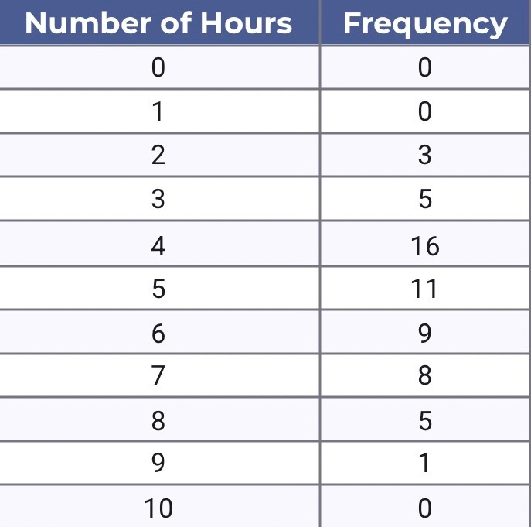
Summary Statistics (N=58)

Slide 5
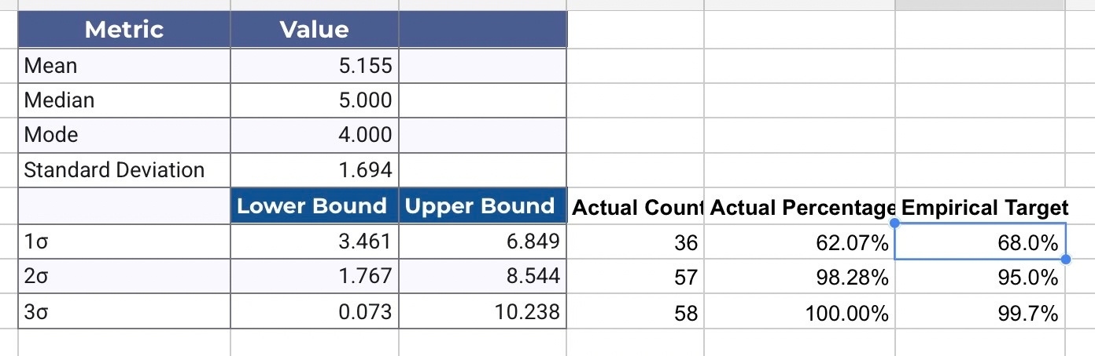
Summary Statistics (N=58)

Slide 6
Empirical Rule vs. Actual Data
Empirical
Rule
Range
Actual
Target
μ ± 1σ
3.46 to 6.85
hours
62.07%
68%
μ ± 2σ
1.77 to 8.54
hours
98.28%
95%
μ ± 3σ
0.07 to 10.24
hours
100%
99.7%

Slide 7
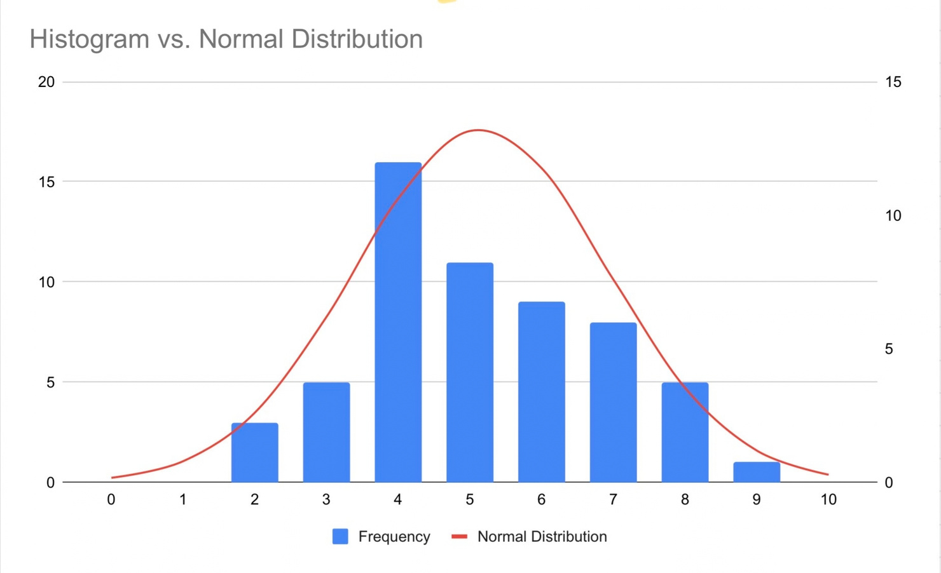
Data Visualization
Peak frequency occurs at 4 hours (16 students) and 5 hours (11 students).

Slide 8


Findings and Analysis
  Symmetry: Near-identical Mean (5.16) and Median (5.00) confirm a balanced distribution.
  Severe Sleep Deficit: The average sleep duration (5.16 hours) is well below the recommended 7 - 9 hours for young adults.
  Systemic Issue: Over 84% of nursing students sleep between 4 and 7 hours, showing sleep loss is a widespread experience rather than isolated student behavior.

Slide 9

Recommendations
  For Nursing Faculty: Stagger clinical exams and avoid clustering major deadlines on consecutive days.
  For Campus Services & Nursing Department: Offer targeted sleep hygiene workshops and open quiet recovery/nap spaces during midterm weeks.
  For Nursing Students: Utilize active recall and structured study schedules to minimize all-night cramming.

